Slide 1

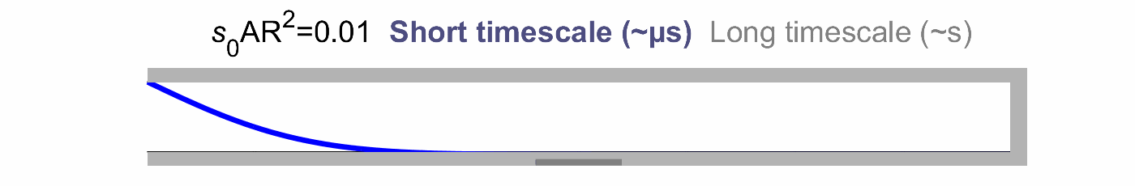
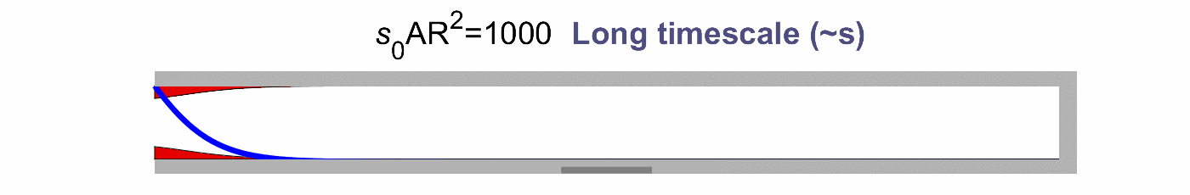
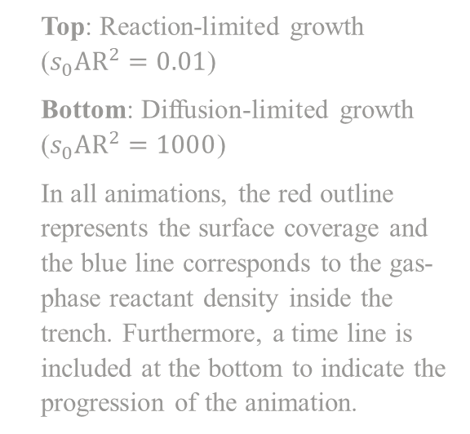
Please cite as: K. Arts, W.M.M. Kessels and H.C.M Knoops. Basic insights into ALD conformality – A closer look at ALD and thin film conformality. 2020, 1. AtomicLimits
Animations play in Slide Show (Shift+F5)
Top: Reaction-limited growth ($s_{0}AR^{2}=0.01$)
Bottom: Diffusion-limited growth ($s_{0}AR^{2}=1000$)
In all animations, the red outline represents the surface coverage and the blue line corresponds to the gas-phase reactant density inside the trench. Furthermore, a time line is included at the bottom to indicate the progression of the animation.

Slide 2
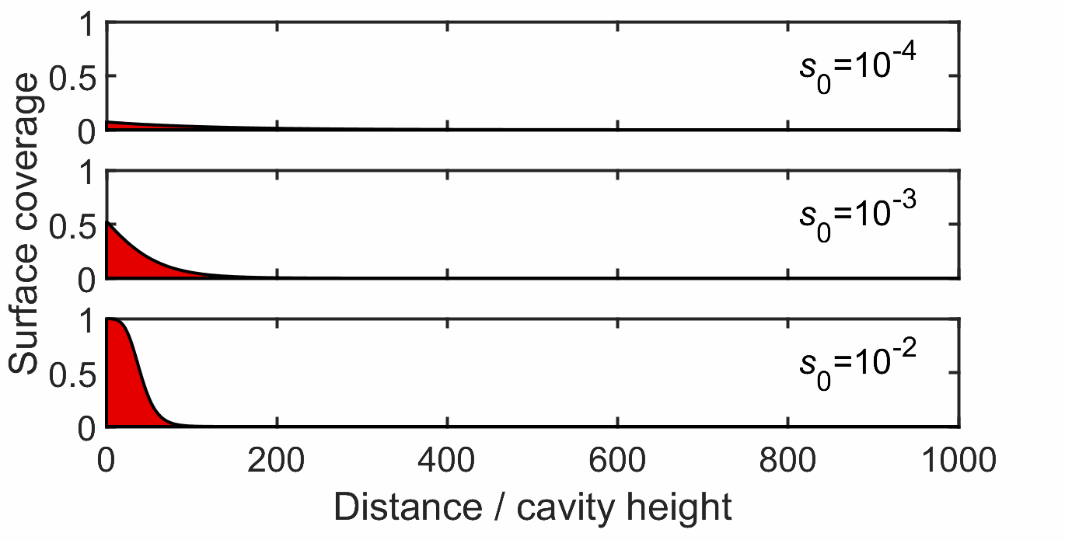
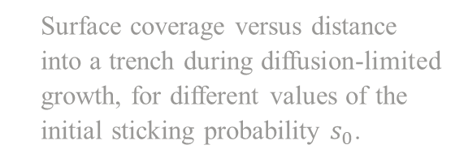
Please cite as: K. Arts, W.M.M. Kessels and H.C.M Knoops. Basic insights into ALD conformality – A closer look at ALD and thin film conformality. 2020, 1. AtomicLimits
Animations play in Slide Show (Shift+F5)
Surface coverage versus distance into a trench during diffusion-limited growth, for different values of the initial sticking probability $s_{0}$.

Slide 3
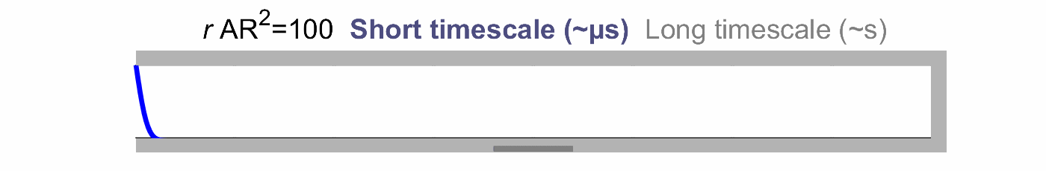
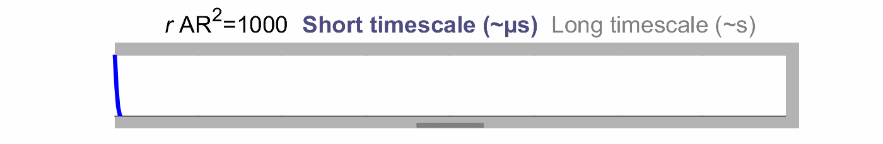
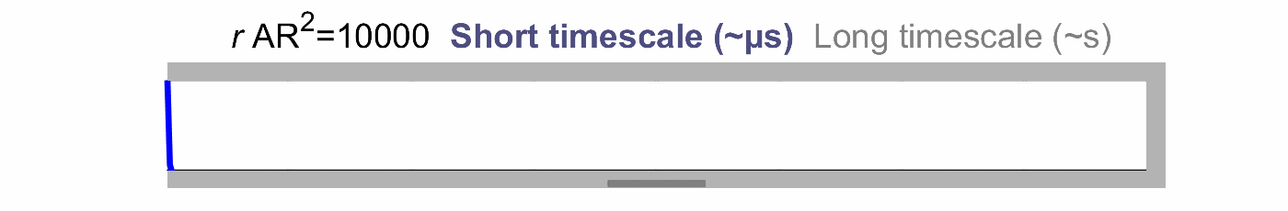
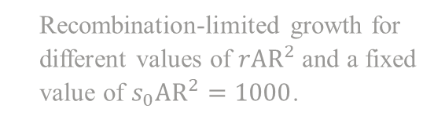
Please cite as: K. Arts, W.M.M. Kessels and H.C.M Knoops. Basic insights into ALD conformality – A closer look at ALD and thin film conformality. 2020, 1. AtomicLimits
Animations play in Slide Show (Shift+F5)
Recombination-limited growth for different values of $rAR^{2}$ and a fixed value of $s_{0}AR^{2}=1000$.

Slide 4
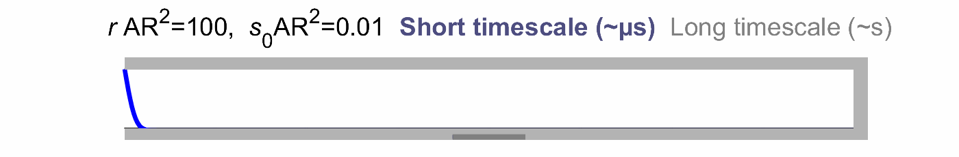
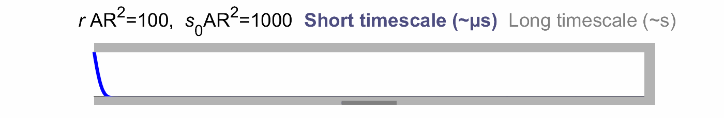
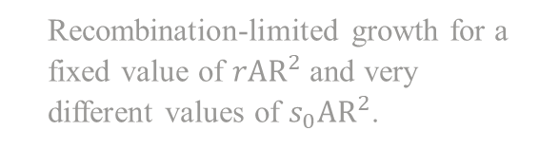
Please cite as: K. Arts, W.M.M. Kessels and H.C.M Knoops. Basic insights into ALD conformality – A closer look at ALD and thin film conformality. 2020, 1. AtomicLimits
Animations play in Slide Show (Shift+F5)
Recombination-limited growth for a fixed value of $rAR^{2}$ and very different values of $s_{0}AR^{2}$.

