Slide 1
Tutorial: Atomic Layer Deposition for Photovoltaics (ALD4PV)
Dr. Bart Macco
Department of Applied Physics

Slide 2
Four take-away messages up front
  The field of ALD4PV is too big to cover fully in 45 mins.
  ALD is already big in the solar industry.
  Various merits of ALD play a key role in many cell concepts.
  High-quality PV materials can be made by doing “smart ALD”.

Slide 3
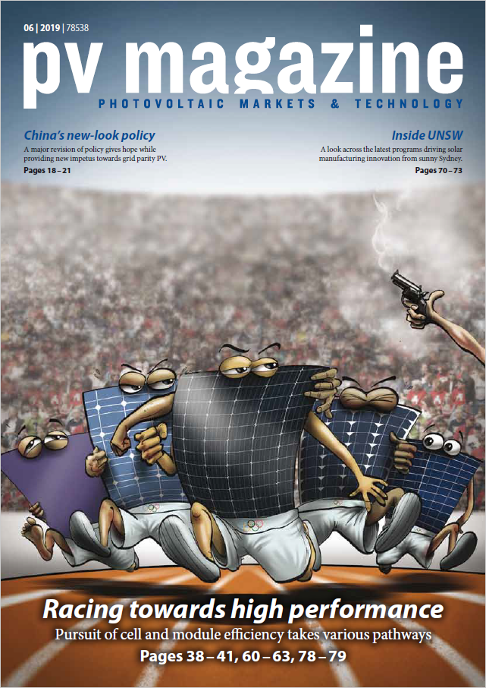
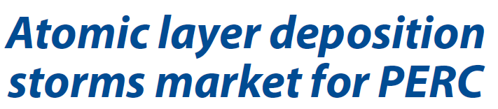
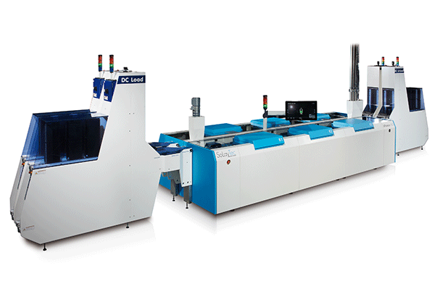
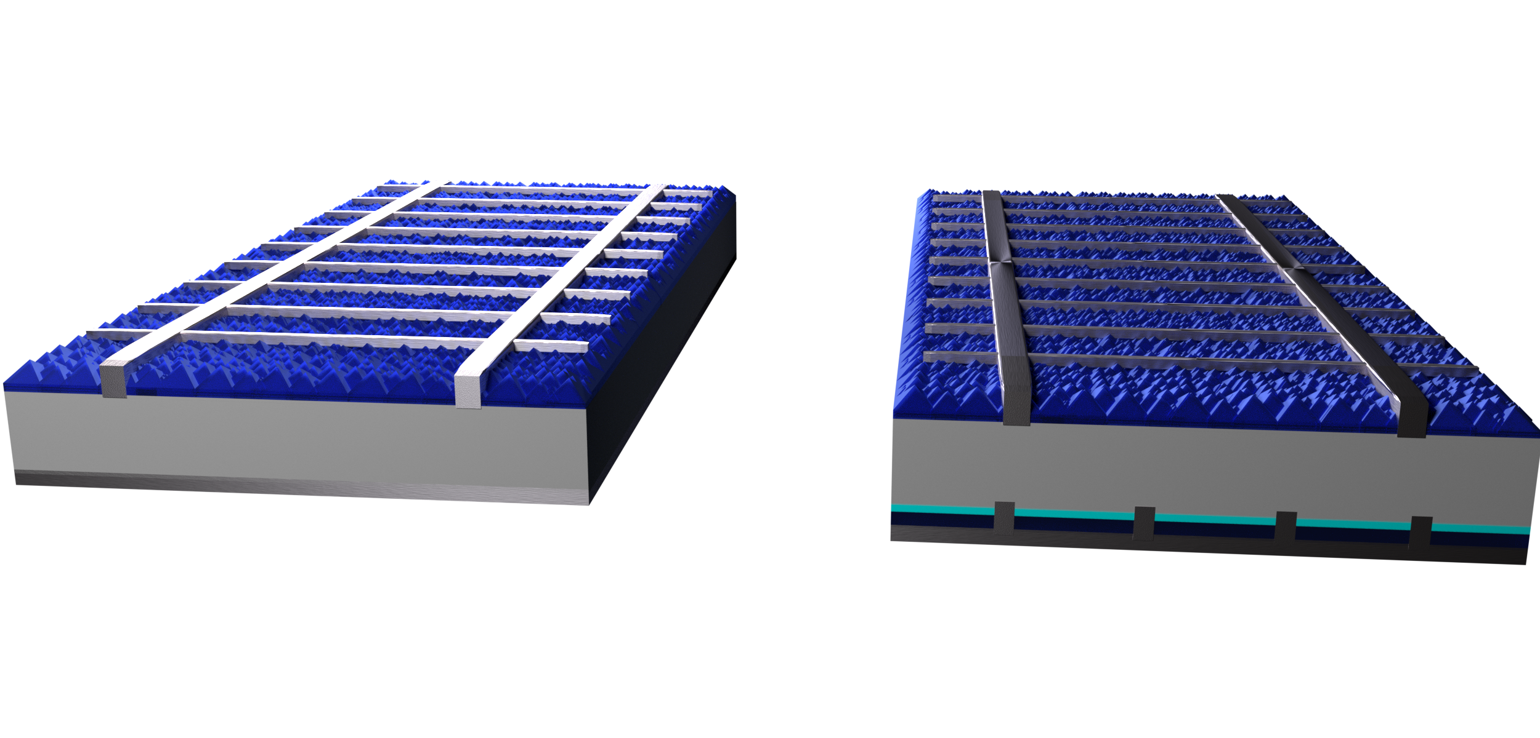
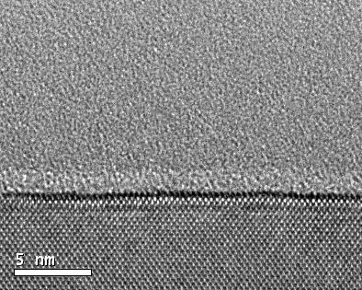
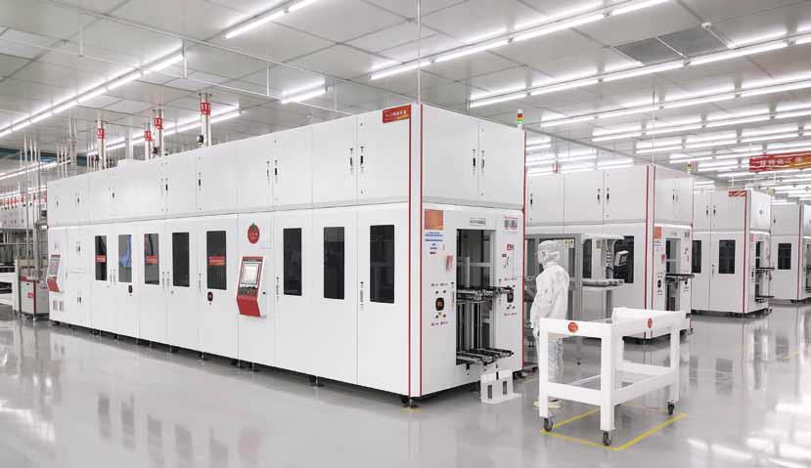
Solaytec spatial ALD
~5 nm ALD Al₂O₃ layers
1-3 wafers/sec
~0.01-0.03 $ per wafer
metallization
Leadmicro batch ALD
SiN_{x}
Al₂O₃
Al₂O₃
n⁺ Si
Silicon
Silicon
Al₂O₃/SiN_{x} stacks
local p⁺ Si
Leadmicro: “Almost all major PV cell manufacturers in China now use our system.”

Slide 4
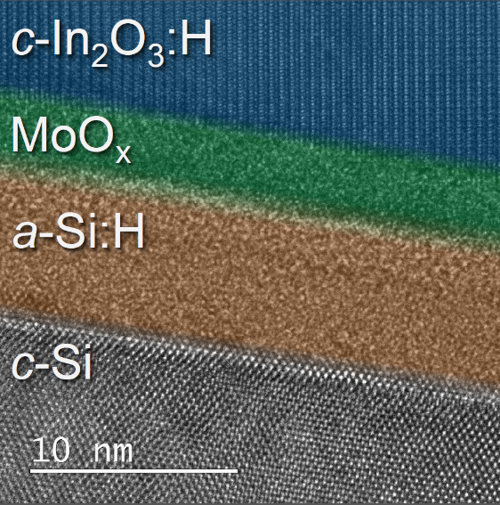
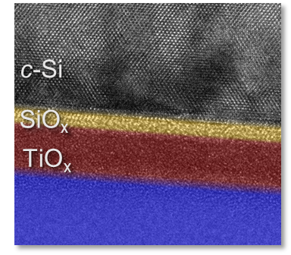
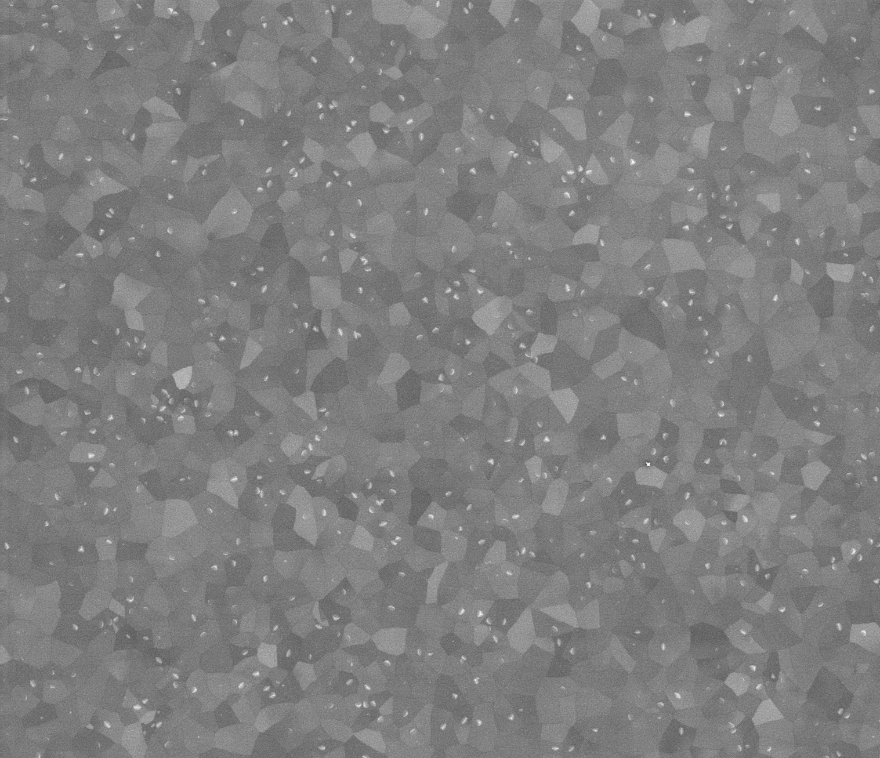
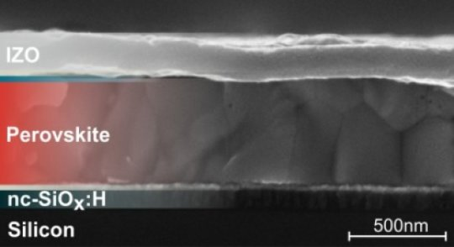
ZnO
ZnO
ALD Transparent
conductive oxides
(TCOs)
New materials & concepts in research!
Gigawatts of ALD Al₂O₃
passivation layers in industry!
Al₂O₃
Al₂O₃
Silicon
Al₂O₃/SiN_{x} stacks
ALD4Perovskites
and tandems

Slide 5
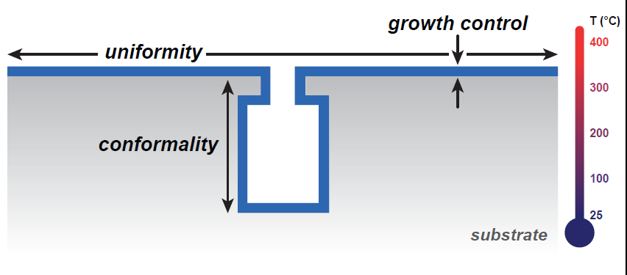
ALD merits: Thickness control, uniformity, conformality, …
Thickness control
Uniformity
Conformality
Many materials
Examples of where these merits really matter throughout the tutorial!

Slide 6
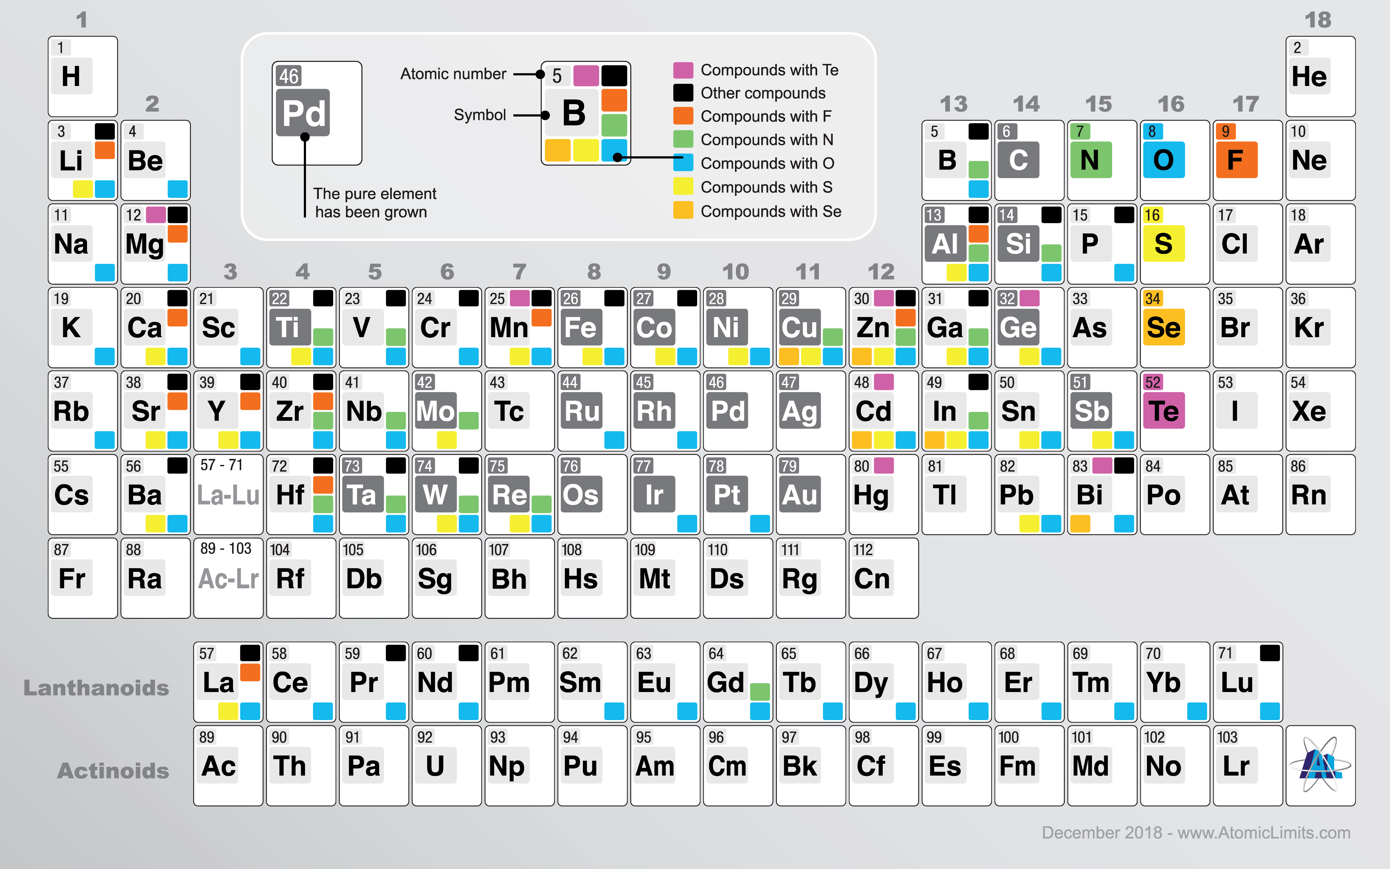
ALD merits: A wide variety of materials
For PV, most interesting:
Metal oxides
Metal (oxy)sulfides
Metal nitrides
(Examples to come…)
New interactive online ALD database:
www.Atomiclimits.com

Slide 7
Outline
  A solar cell crash course
  ALD4SiPV: From passivation layers to passivating contacts
  ALD4TCOs: Transparent conductive oxides
  ALD4Perovskite (tandems)
  Personal outlook

Slide 8
A solar cell crash course
hν
hν
hν
Photogeneration of excess
electrons and holes in semiconductor
upon light absorption
On opposite sides, regions (often thin films)
that let only electrons or holes pass
Extract current via external circuit
hν
hν
External load
hν
Semiconductor (Si, …)

Slide 9
ALD4SiPV:
From passivation layers to passivating contacts

Slide 10
Basics of surface passivation
electrons
Photogeneration of excess
electrons and holes
Recombination, mainly through
surface defects
Equilibrium concentration by balance
of generation and recombination
Conduction band
hν
Valence band
holes
Semiconductor (Si, …)

Slide 11
Basics of surface passivation
Use thin films to reduce recombination at surface of semiconductor.
Chemical passivation: Reduce # of surface defects
Dielectric
e.g. Al₂O₃
Surface defect states
ALD Al₂O₃
electrons
H
H
Conduction band
Thermal annealing
Thermal annealing
SiO_{x}
Valence band
silicon
holes

Slide 12
Basics of surface passivation
Dielectric
e.g. Al₂O₃
Use thin films to reduce recombination at surface of semiconductor.
Chemical passivation: Reduce # of surface defects
Field-effect passivation: Repel one type of charge carrier
electrons
ALD Al₂O₃
Conduction band
Negative interfacial
trapped charge
Negative interfacial
trapped charge
SiO_{x}
Valence band
silicon
holes
E-field
Easiest to repel the minority carrier:
n-type silicon ➔ positive fixed charge
p-type silicon ➔ negative fixed charge

Slide 13
From Al-BSF to PERC
metallization
SiN_{x}
c-Si wafer (textured)
n⁺ Si
p⁺ Si
Al-BSF cell, efficiency ~20%
Al₂O₃/SiN_{x} stacks
Used to be the industrial standard
Limited by recombination
at the rear metal-silicon interface
local p⁺ Si
PERC cell, efficiency ~22-23%
New industrial standard
Rear side mostly passivated by Al₂O₃/SiN_{x},
with small local metal-silicon contacts

Slide 14
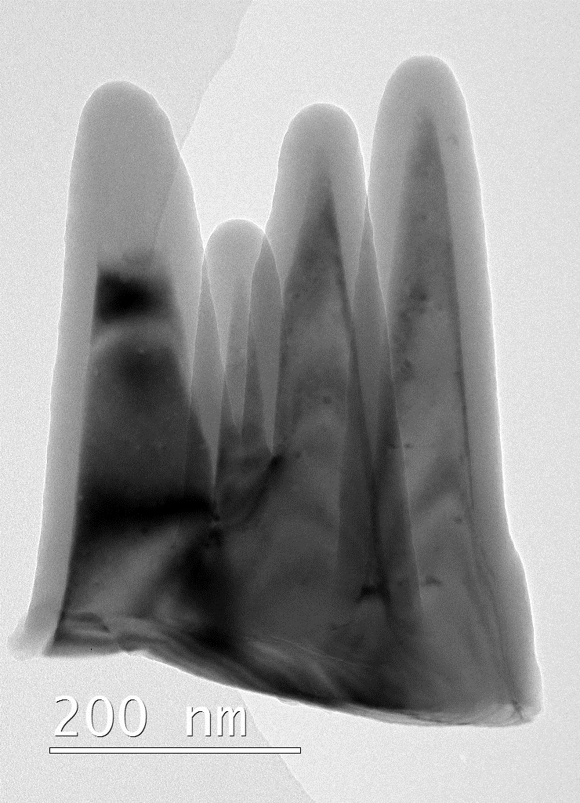
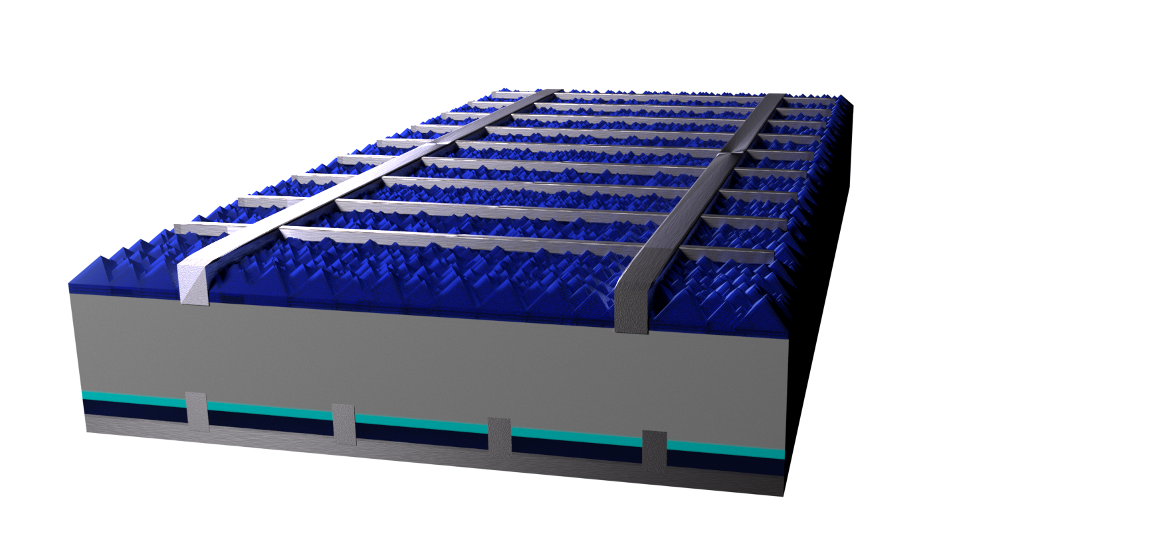
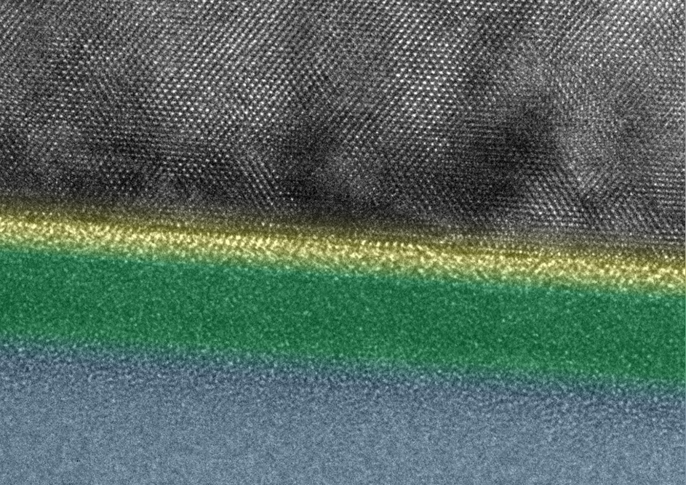
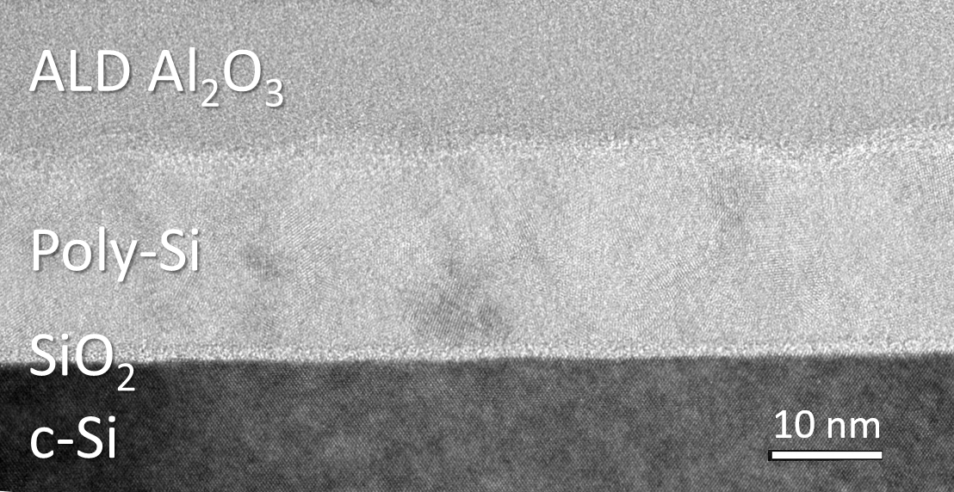
Trends in silicon photovoltaics
Black silicon
New passivation materials
Passivating contacts
Many more …
SiN_{x}
metallization
c-Si
SiO_{x}
TiO_{x}
c-Si wafer (textured)
n⁺ Si
ALD Al₂O₃
local p⁺ Si
Poly-Si
SiO_{x}
Al₂O₃/SiN_{x} stacks
c-Si

Slide 15
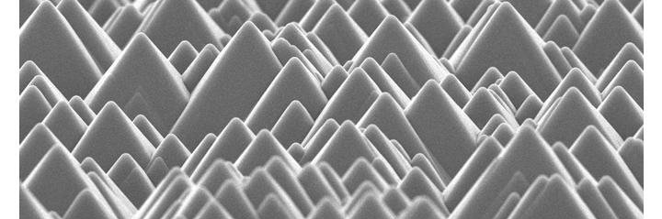
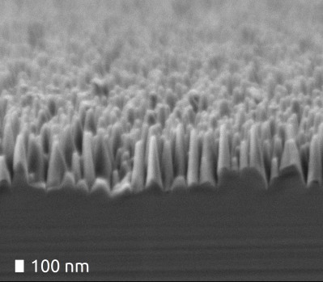
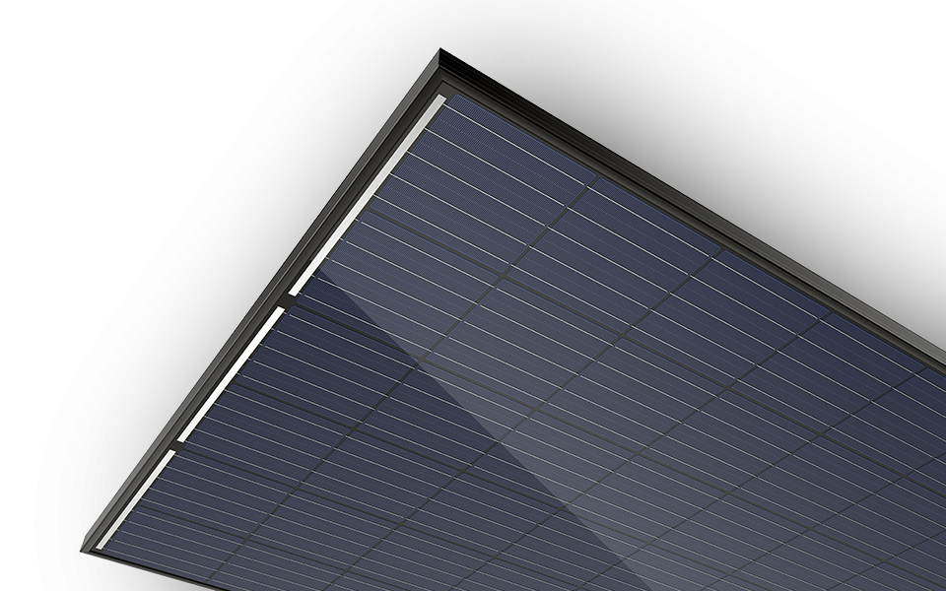
ALD for passivation of black silicon
Conformality of ALD Al₂O₃ crucial for coating pillars
Although not very common,
you can buy such modules
Standard pyramid texture
e.g. Trina ALLMAX-PD05.05
Black silicon: Nanotextured surface
H. Savin et al., Nat. Nanotechnol., 10, 7, 624–628, 2015.
van de Loo et al., Appl. Phys. Lett. 110, 263106 (2017)
Ref book chapter

Slide 16
A brief history of silicon passivation layers
[4] Feldmann et al, ”Sol. Energy Mater. Sol. Cells, vol. 131, pp. 46–50, 2014.
[5] Black et al., Sol. Energy Mater. Sol. Cells, vol. 188, no. June, pp. 182–189, 2018.
[1] Jäger and Hezel, Proc. 18th IEEE PVSC, Las Vegas, pp. 1752–1753, 1985.
[2] B. Hoex et al., Appl. Phys. Lett., vol. 89, no. 4, p. 042112, 2006.
[3] G. Agostinelli et al., Sol. Energy Mater. Sol. Cells, vol. 90, no. 18–19, pp. 3438–3443, Nov. 2006.

Slide 17
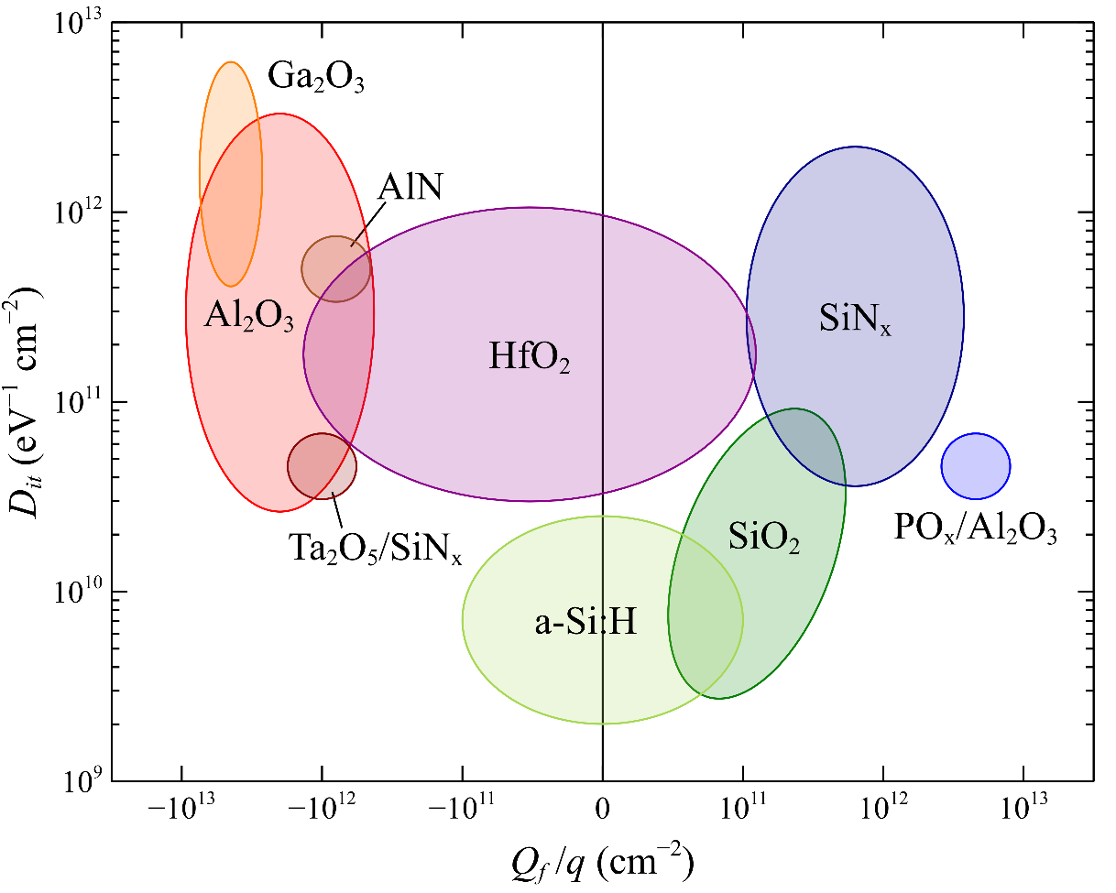
Many new ALD materials for passivation: PO_{x}/Al₂O₃
Unique:
Strong positively
charged oxide!
Defect density
Nb₂O₅
Good for p-type Si⬅
Fixed charge
➔Good for n-type Si
Adapted from Cuevas et al.

Slide 18
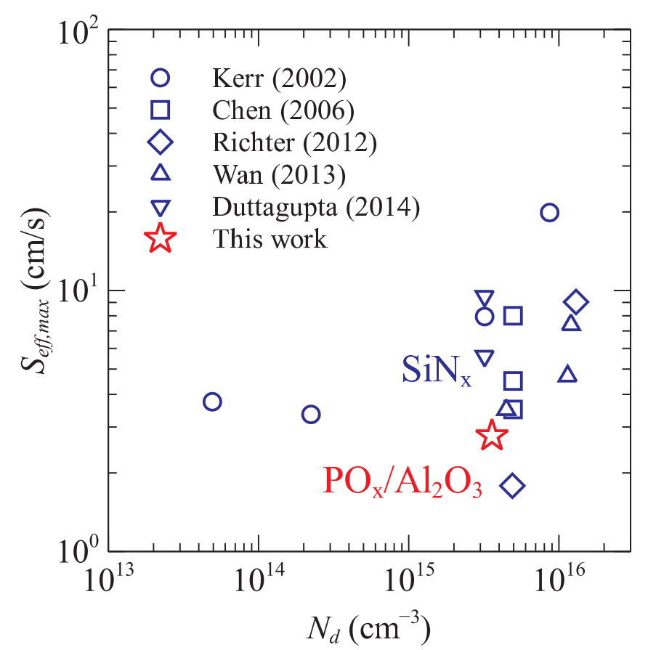
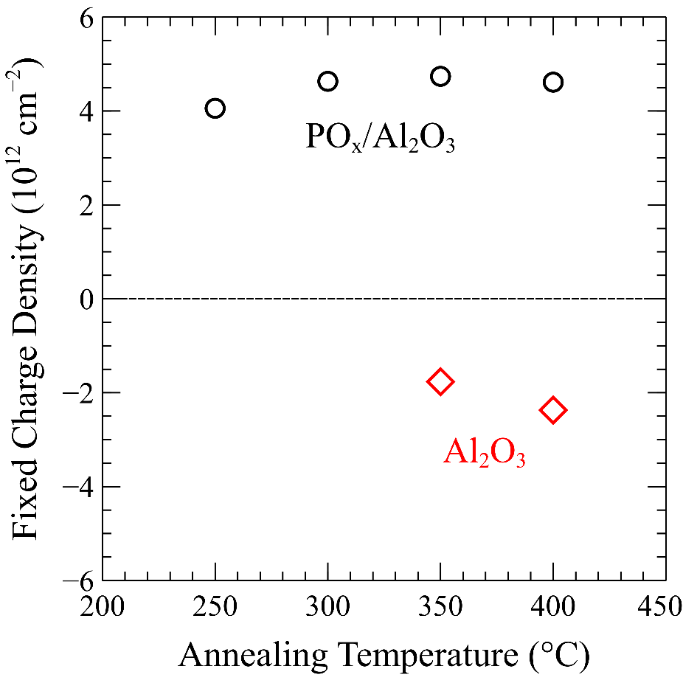
Many new ALD materials for passivation: PO_{x}/Al₂O₃
Precursors: Trimethylphosphate (TMP) & TMA + O₂ plasma
SiN_{x}
PO_{x}/AlO_{x}
n⁺ FSF
c-Si(p)
p⁺ LBSF
As good as best
SiN_{x} on n-type surfaces
Thanks to
positive fixed charge
Front side PERC cell?
& laser P dopant source?
Black et al,. Appl. Phys. Lett. 2018, 112 (20), 201603.
Black et al., Sol. Energy Mater. Sol. Cells 2018, 185 (March), 385–391.

Slide 19
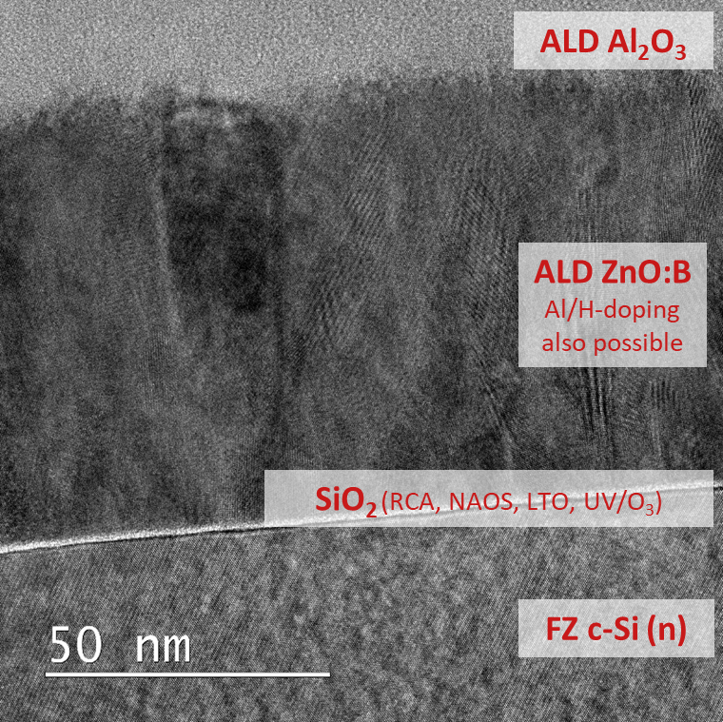
Many new ALD materials for passivation: conductive ZnO
State-of-the-art passivation (~730 mV)
Unique: a very conductive passivation layer! ➔ Opens up new cell concepts
Perfect doping control by ALD
Doping helps field-effect passivation
Doping helps tunneling over oxide
Soft ALD deposition is key
Tunnel oxide for chemical passivation
cannot withstand plasma PVD, …
van de Loo et al., J. Appl. Phys., vol. 125, no. 10, p. 105305, 2019

Slide 20
From passivation layers to passivating contacts
A passivating contact:
A layer that passivates the silicon surface,
selectively letting one carrier type (e/h) pass
h-selective
membrane
e-selective
membrane
Conduction band
External load
Valence band
e-h
recombine
Can be achieved in various ways:
Doping, band offsets, work function difference, …
Beyond the scope to explain mechanisms,
see “Further reading” slides
semiconductor

Slide 21
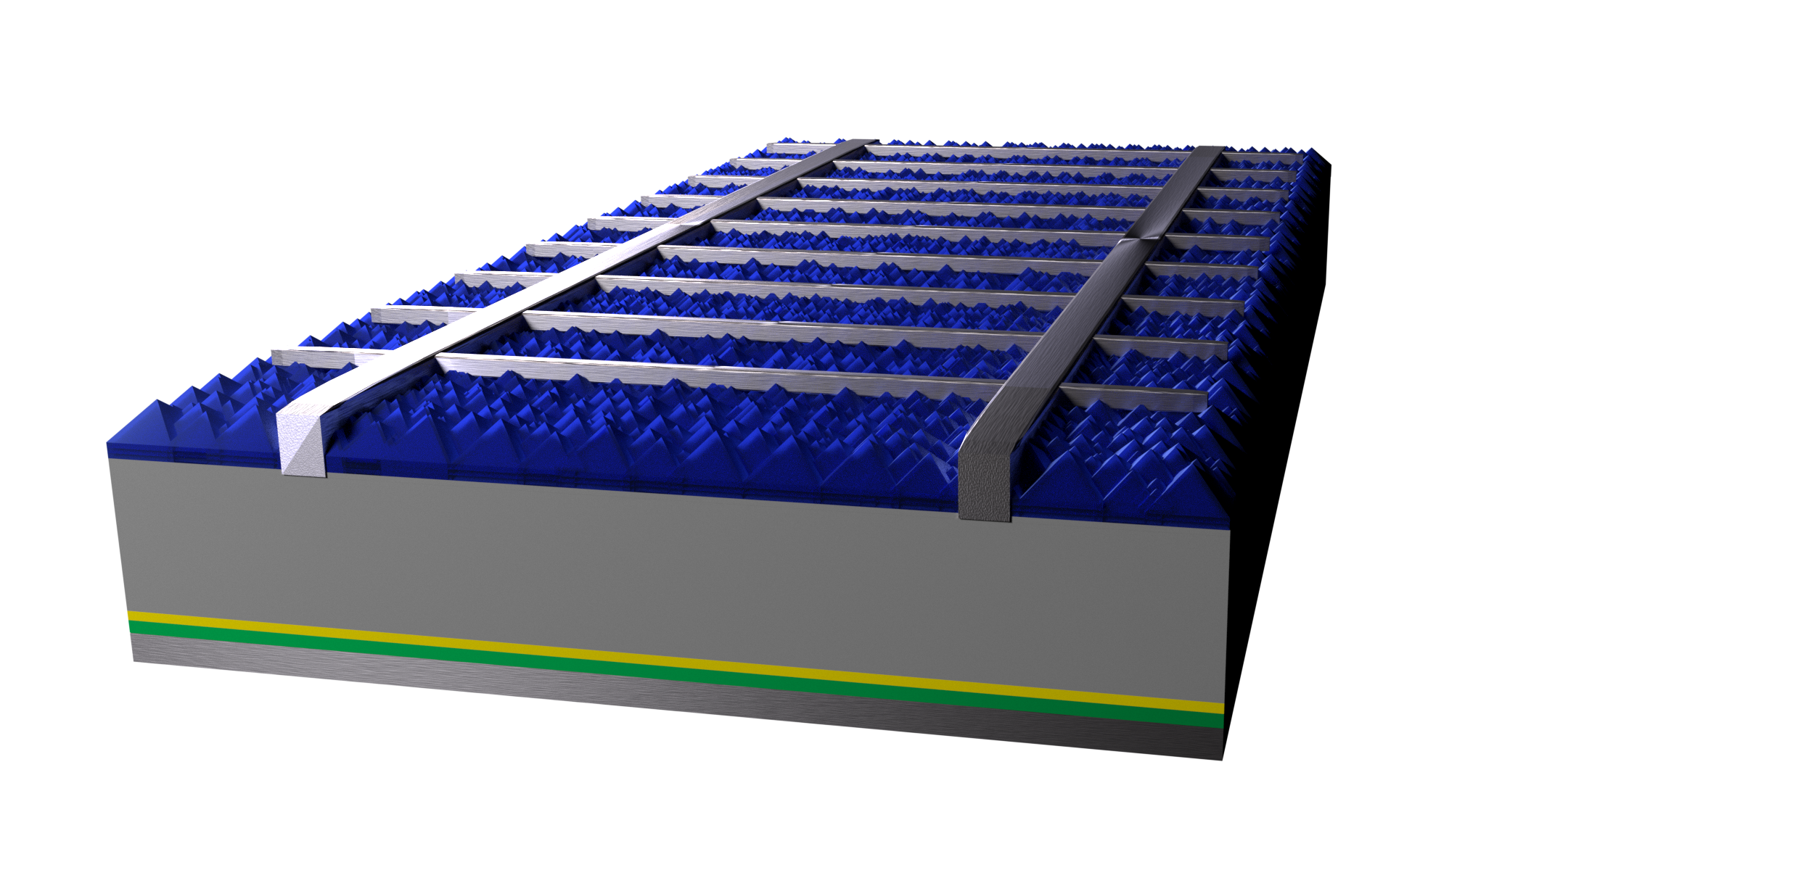
Passivating contacts based on ALD metal oxides
SiN_{x}
metallization
p⁺ Si
n-type Si
TiO₂
c-Si wafer (textured)
c-Si
E_{F}
SiO_{x}
metal
TiO_{x}
TiO₂ as e-selective contact
➔ 22.1% efficiency
Only 3 nm needed
ALD: Thickness control,
6” uniformity
Simple and cheap ALD!
TiCl₄, H₂O, 75 ºC
Works by conduction band alignment
Yang et al., Progress in Photovoltaics: Research and Applications, 25(11), 896–904 (2017)

Slide 22
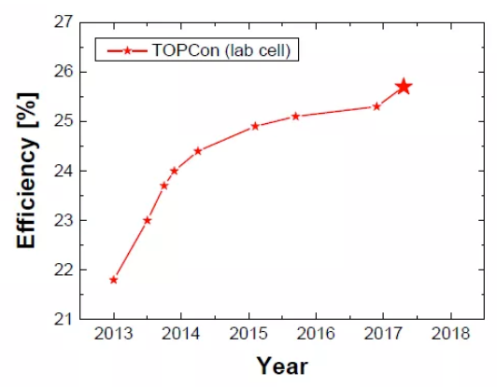
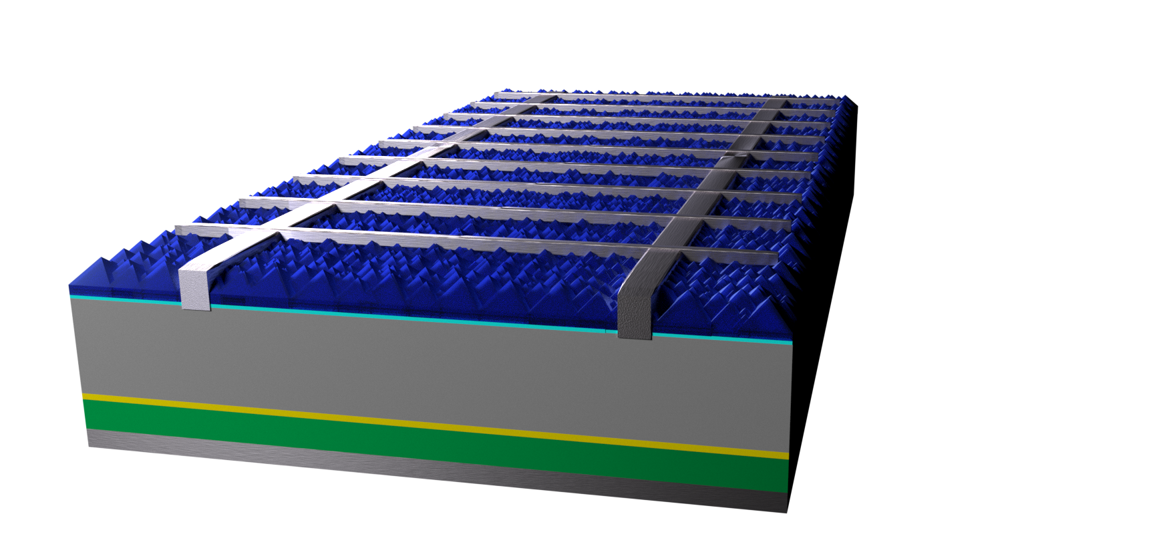
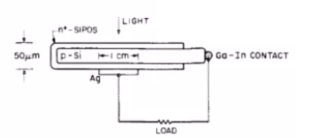
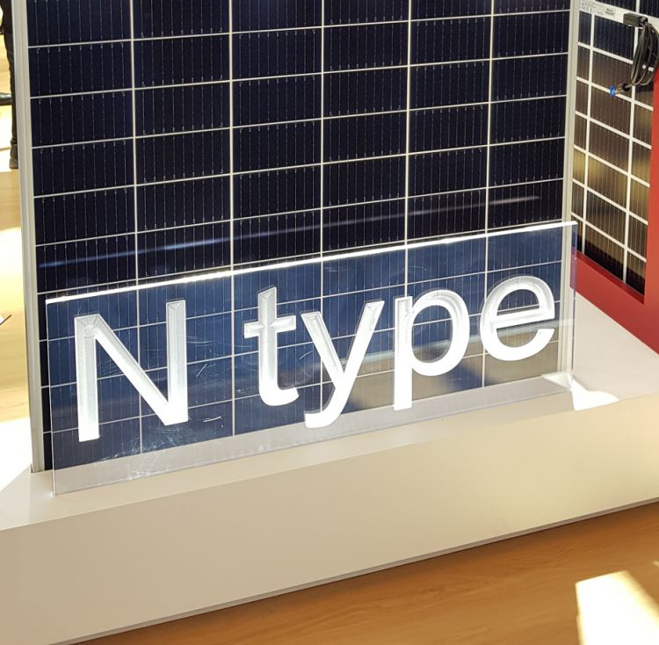
Poly-Si passivating contacts
metallization
p⁺ Si
Al₂O₃/SiN_{x}
c-Si
c-Si wafer (textured)
SiO_{x}
2013: Rediscovered by F-ISE¹
Poly-Si(n)
2019:
Buy them!²
cell > 24%
Concept borrowed from transistors
in the 80s! (SIPOS)
¹F. Feldmann, https://www.atomiclimits.com/2018/07/23/looking-back-at-the-passivating-contact-workshop-in-eindhoven-passivating-contact-materials-based-on-silicon/
²https://www.pv-tech.org/products/trina-solar-launches-425wp-bifacial-i-topcon-module

Slide 23
Hydrogenation layers for poly-Si contacts
Hydrogenation of tunnel oxide is crucial for chemical passivation!
ALD Al₂O₃ has proven to be an excellent hydrogenation source!
712 mV
ALD Al₂O₃
H H H H
688 mV
Voltage
Poly-Si
666 mV
SiO_{x}
As-dep
Forming
gas anneal
ALD Al₂O₃
+anneal
c-Si
M. Schnabel et al., Appl. Phys. Lett., 112, 20, 203901 2018.
B.W.H. van de Loo et al., (submitted)

Slide 24
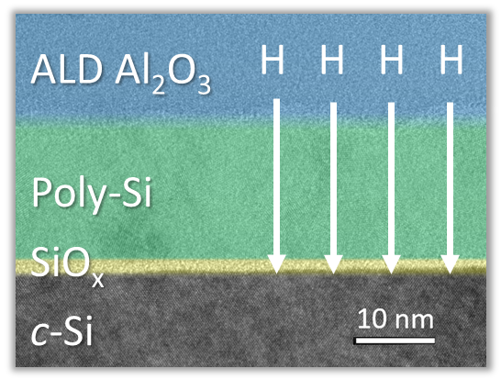
To sum up this part…
TODO: Change to PERC cell and add timeline fig Aaf
And very much present in novel concepts!
ALD is already
big in industry ….
Black silicon
c-Si wafer (textured)
Novel passivation materials
Passivating contacts
c-Si
ALD Al₂O₃ in PERC
SiO_{x}
TiO_{x}

Slide 25
ALD4TCOs:
ALD for transparent conductive oxides

Slide 26
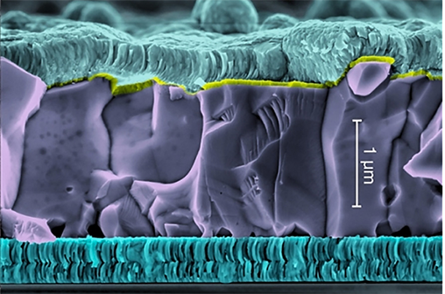
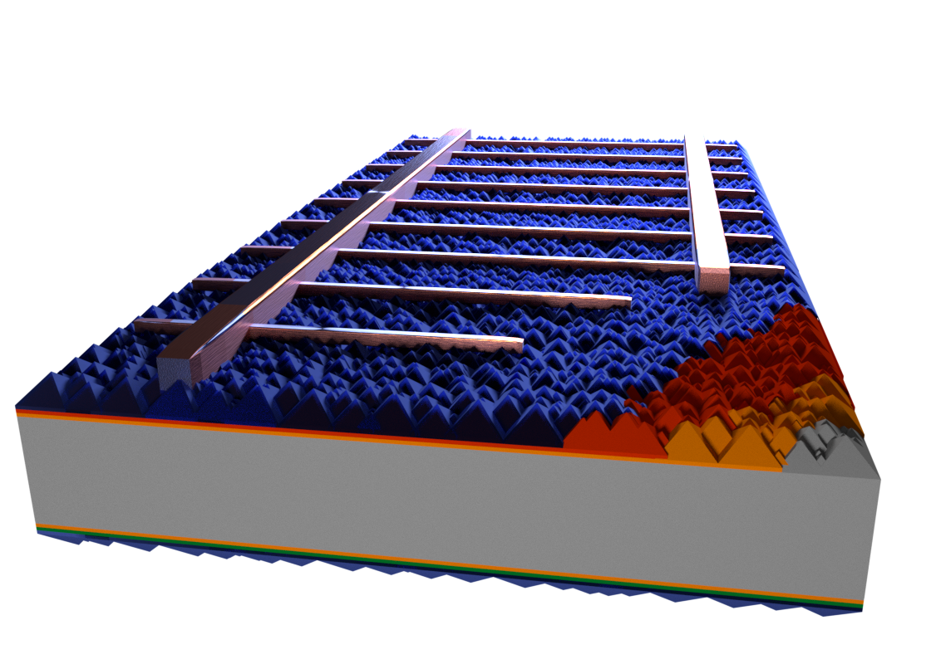
Basics of transparent conductive oxides (TCOs)
CIGS
TCOs found in many cell types for lateral electrical transport.
Mostly sputtering (PVD)
Transparency: Wide bandgap host (~>3 eV) ➔ In₂O₃, ZnO, SnO₂, …
Conductivity: Dopants ➔ Sn, Al, B, F, H, … ➔ ρ ~< 1 mΩcm
Perovskite
CB
E_{F}
BM-shift
E_{F}
Si heterojunction
VB
Free carrier absorption
Intrinsic
host
+ doping

Slide 27
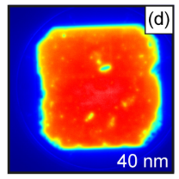
3 challenges and opportunities for ALD TCOs
e⁻
Achieve efficient doping
by avoiding dopant clustering
Make high mobility TCOs
by avoiding scattering
Avoid substrate damage
by “soft deposition”

Slide 28
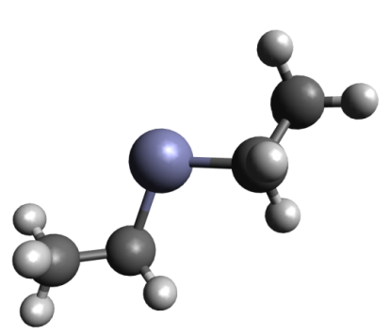
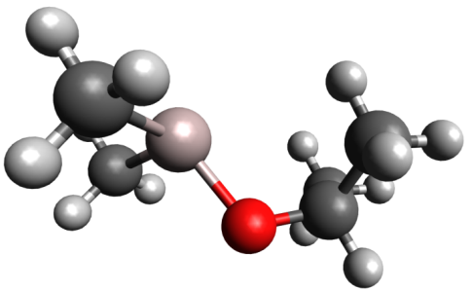
Making doped TCOs by ALD: The supercycle approach
DMAI
n cycles host TCO
ZnO:Al from DEZ and DMAI
1 cycle dopant
Digital doping control
N_{e} = 7∙10¹⁹-1∙10²¹ cm⁻³
ZnO
Al doping
precursor
DEZ
DMAI
reactant
H₂O
H₂O
purge
purge
purge
time
n cycles
1 cycle
1 supercycle
Wu et al. (2013). Chemistry of Materials, 25(22), 4619–4622.

Slide 29
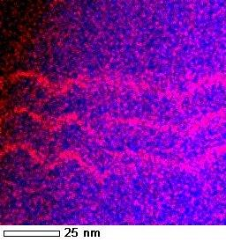
The case of ALD Al-doped ZnO
Clustered dopants
Low doping efficiency
Dispersed dopants
Enhanced doping efficiency
Vertical control by
supercycle ratio
How to achieve more lateral spacing?
Or: How to reduce #Al atoms/cycle?
TMA doping in ZnO

Slide 30
The case of ALD Al-doped ZnO
Yanguas-Gil et al., Chem. Mater. 2011, 23, 4295–4297.
Na et al. Chem. Mater. 2009, 21 (6), 5585–5593.
Park et al., Appl. Surf. Sci. 2014, 309, 133–137.
Achieve less Al/cycle by cycle modifications:
Partially block TMA absorption by dosing alcohols prior to TMA¹
Omit H₂O dose before TMA²
3. Introduce a long wait step before TMA => dehydroxylation¹³
EtOH
EtOH
Al(CH)_{x}
Al(CH)_{x}
Al(CH)_{x}
EtOH
EtOH
OH
OH
OH
OH
OH
OH
OH
OH
ZnO
EtOH
TMA
ZnEt
ZnEt
Al(CH)_{x}
Al(CH)_{x}
Al(CH)_{x}
OH
OH
OH
ZnEt
ZnEt
TMA
H₂O
H₂O
Al(CH)_{x}
Al(CH)_{x}
Al(CH)_{x}
OH
OH
OH
OH
OH
WAIT
OH
O
OH
O
O
O
ZnO
TMA

Slide 31
The case of ALD Al-doped ZnO
4. Use steric hindrance of bulkier dopant precursors
TMA
as dopant precursor
Clustered dopants
Low doping efficiency
Low steric hindrance
High # Al atoms nm⁻² cycle⁻¹
~11 Al atoms/nm²·cycle
Doping efficiency = 5-10%
Resistivity = 2.4 mΩ·cm
CH₃
CH₃
Al
OH
OH
OH
OH
OH
O
OH
“Bulkier” DMAI
as dopant precursor
Dispersed dopants
Enhanced doping efficiency
Enhanced steric hindrance
Low # Al atoms nm⁻² cycle⁻¹
~0.3 Al atoms/nm²·cycle
Doping efficiency = >30%
Resistivity = 0.7 mΩ·cm
CH₃
HC
O
CH₃
CH₃
Al
OH
OH
OH
OH
OH
O
OH
Wu et al., Chem. Mater. 2013, 25 (22), 4619–4622.
Macco et al., Semicond. Sci. Technol. 2014, 29 (12), 122001.

Slide 32


DMAI: Al-doped ZnO in silicon heterojunction cells
Replace scarce indium-tin-oxide (ITO)
with abundant ALD ZnO:Al at the rear
ITO
Both ITO and ZnO:Al
efficiency of 21.3%
a-Si:H (i/p)
c-Si(n)
a-Si:H (i/n)
ITO ➔ ZnO:Al
Niemelä et al., Sol. Energy Mater. Sol. Cells 2019, 200, 109953.

Slide 33

High-mobility ALD TCOs
35 cm²/Vs
A high carrier density ➔ free carrier absorption
138 cm²/Vs
$$ρ=\frac{1}{N_{e}μe}$$
A high mobility μ allows for
a low carrier density N_{e}
Scattering at grain boundaries limits the mobility.
Mitigate grain boundary scattering by:
Enhancing grain size
Passivating boundaries with hydrogen
e⁻
H
e⁻
H
H
H
H

Slide 34
High-mobility ALD TCOs: ZnO:H
~3 at. %
The H₂ plasma:
Dopes the ZnO with H
Reduces grain competition by etching nuclei:
Use supercycles of ZnO with H₂ plasma
ZnO cycle
Doping/etching
Etching H₂ plasma
precursor
DEZ
H₂ plasma
reactant
H₂O
purge
purge
time
Substrate
n cycles
1 cycle
1 supercycle
Macco et al, SOLMAT 173 (2017) 111-119
Macco et al., Semicond. Sci. Technol. 29 (2014) 122001
Demaurex et al., IEEE J. Photovoltaics. 4 (2014) 1387–1396.

Slide 35
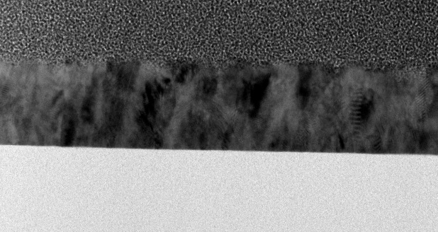

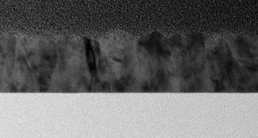

High-mobility ALD TCOs: ZnO:H
Without H₂ plasma
TEM cross-section
Mobility 27 cm²/Vs
No H₂ plasma
H₂ plasma :
Tune delay!
With H₂ plasma
Mobility 48 cm²/Vs
With H₂ plasma
(Max mobility ~ 55 cm²/Vs

Slide 36
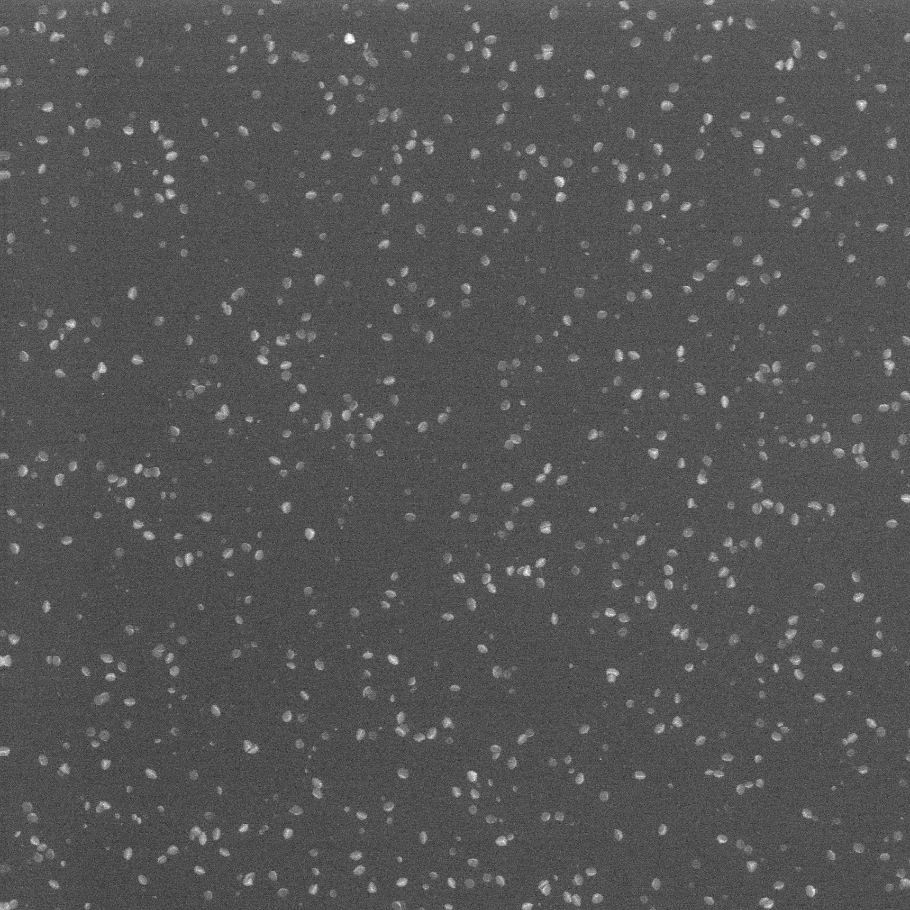
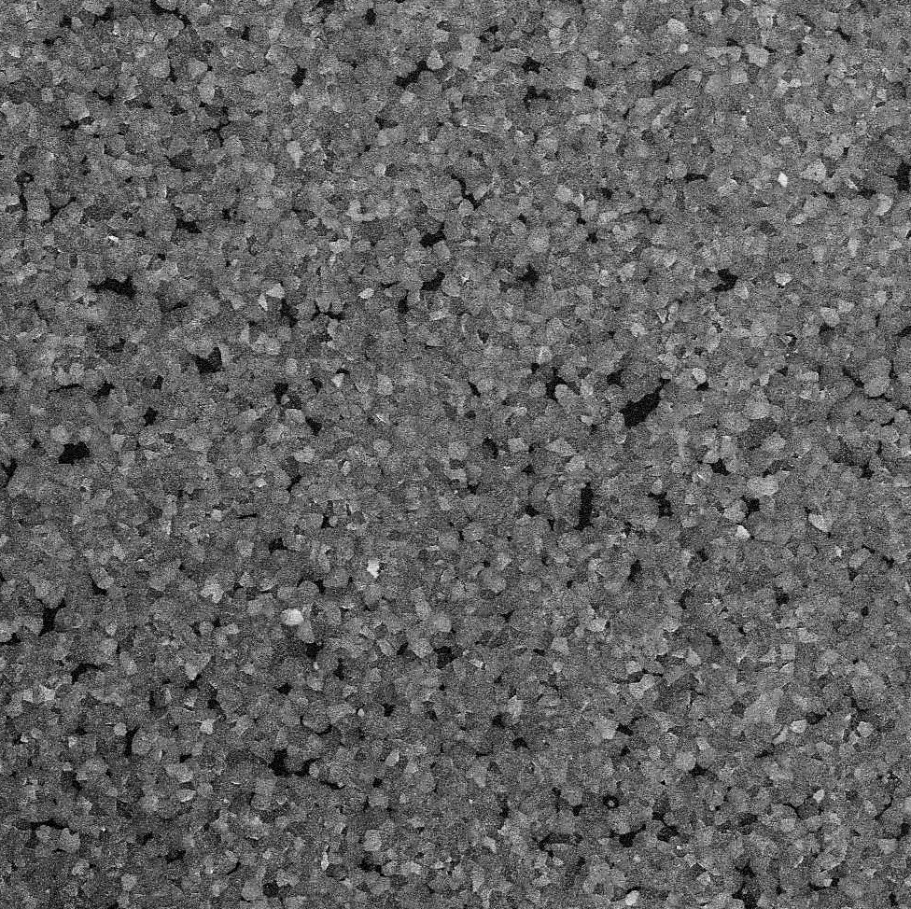
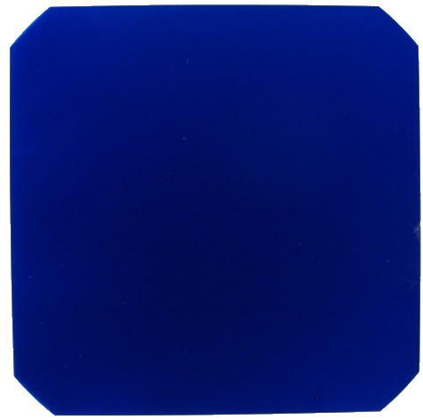
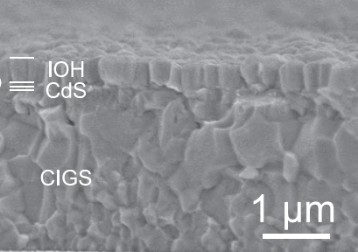
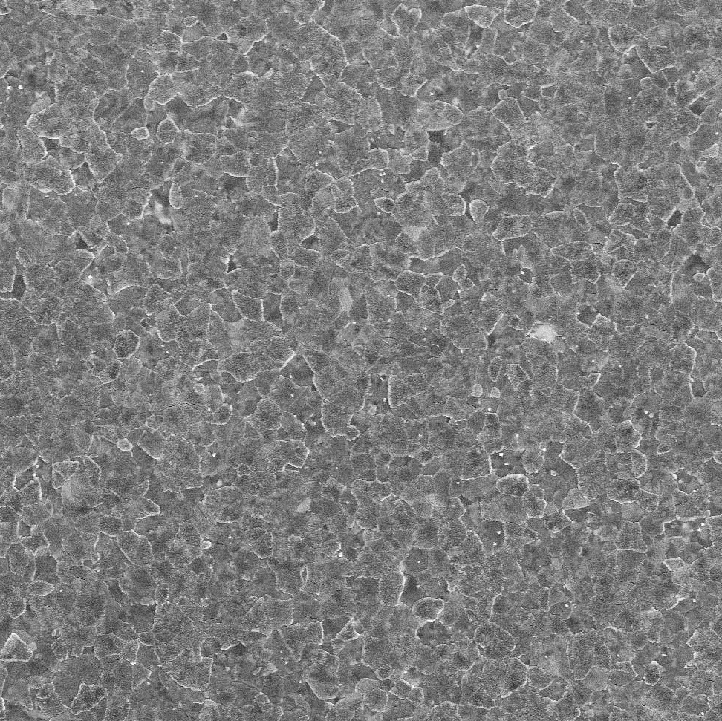
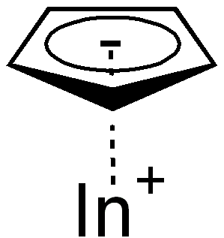
High-mobility ALD TCOs: In₂O₃:H
High-mobility and
polycrystalline In₂O₃:H
μ=130 cm²/Vs
Anneal
150-200 ºC
100 ºC
Amorphous
+ embedded crystallites
μ=37 cm²/Vs
“semicrystalline”
μ=68 cm²/Vs
HIT-cell²
+1.7 mA/cm²
T_{dep}
polycrystalline
μ=35 cm²/Vs
Precursor
Reactants
CIGS:³
+1.7 mA/cm²
H₂O + O₂
InCp
200 ºC
¹ Macco et al, Journal of Applied Physics 120(8) 085314 (2016)
² Y. Kuang et al., Sol. Energy Mater. Sol. Cells, 163, January, 43–50, 2017.
³ Keller et al., Prog. Photovoltaics Res. Appl., 24, 1,102–107, 2016.

Slide 37
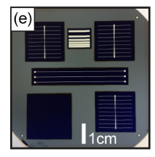
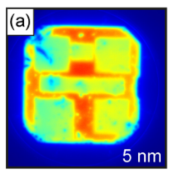
Soft deposition of ALD TCOs
Silicon heterojunction
Cell mask layout
Sputter TCO:
Sputter damage
ALD TCO:
No damage
Sputtering: Energetic ions and photons can create defects in passivation layer.
Thermal ALD ➔ No plasma defects!

Slide 38
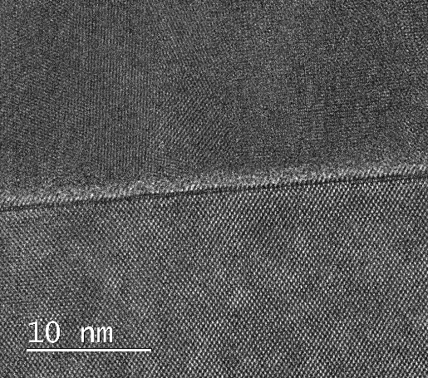
Soft deposition of ALD TCOs
Soft deposition is growing increasingly important for newer cell concepts
a-Si:H passivation:
~Full recovery
by annealing¹
Poly-Si passivation:
Partial recovery
by annealing²
Perovskites
killed
by plasma³
Tunnel SiO₂/ZnO
SiO₂ killed
by plasma⁴
ZnO:B
SiO₂
c-Si
¹ Demaurex et al., Appl. Phys. Lett., vol. 101, no. 17, p. 171604, 2012.
² Tutsch et al., Sol. Energy Mater. Sol. Cells, vol. 200, no. May, p. 109960, 2019.
³ Zardetto et al., Sustain. Energy Fuels, vol. 1, no. 1, pp. 30–55, 2017.
⁴ van de Loo et al., J. Appl. Phys., vol. 125, no. 10, p. 105305, 2019

Slide 39
ALD for perovskite and tandems

Slide 40
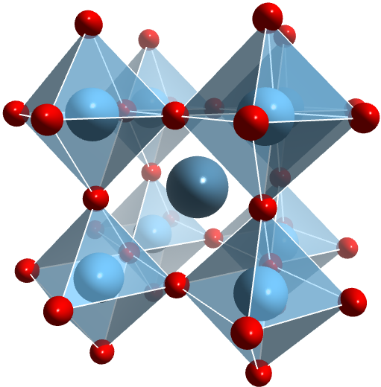
The rise of perovskite and Si-perovskite tandems
Perovskite
Silicon
Impressive efficiency rise
for perovskite & Si-perovskite tandems

Slide 41
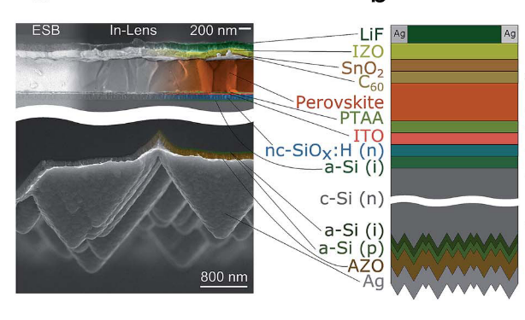
ALD SnO₂ as buffer layer in c-Si/perovskite tandems
~10-20 nm ALD SnO₂ used in recent record tandems ^{1,2,3}
+ Soft sputter protection layer
+ Conformal, low-pinhole density layer
for environmental stability
[1] E. Köhnen et al., Sustain. Energy Fuels, 2019.
[2] M. Jošt et al., Energy Environ. Sci., 2019.
[3] F. Sahli et al.,” Nat. Mater., Jun. 2018.

Slide 42
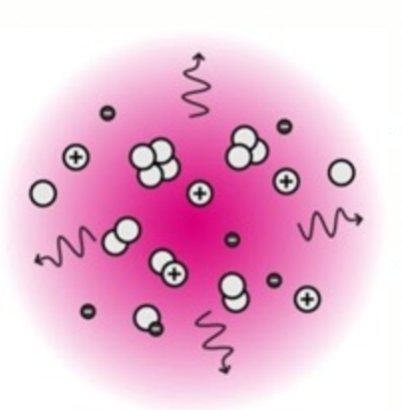
ALD on challenging perovskite “substrates”
TDMASn
DEZ
TMA
Thermal stability¹
Limit thermal budget!
Or “quick” processing
No plasma processes²
Chemical stability^{3,4}
Precursors can react with perovskite
¹ Tan et al., ACS Appl. Mater. Interfaces, 10, 6, 5485–5491, 2018.
² Zardetto et al., Sustain. Energy Fuels, 1, 1, 30–55, 2017.
³ Hultqvist et al., ACS Appl. Mater. Interfaces, 9, 35, 29707–29716, 2017.
⁴ Palmstrom et al., Adv. Energy Mater., p. 1800591, 2018.

Slide 43



ALD for interface engineering of perovskites
Ultrathin ALD Al₂O₃ on perovskite
Conformal
Passivating
while allowing for tunneling
Stabilizing
Moisture barrier
Dry N₂
40% RH
60% RH
50-70% RH
Spiro-OMeTAD
+ “Passivation”
Al₂O₃
- Too thick for tunneling
Perovskite
Koushik et al., Energy & Envir.Science, 10, 91-100 (2017)
Koushik et al, Advanced Mat. Interfaces 1700043 (2017)

Slide 44


Conformal ALD NiO for CIGS/Perovskite tandem
Roughness up to 1 µm
➔ Pinholes for solution-processed PTAA hole-contact
Solution: Introduce conformal, pinhole-free ALD NiO hole-contact
21.6%
18.2%
Efficiency:
3.6%
PTAA
only
ALD NiO
only
ALD NiO
+ PTAA
M. Jost et al.,” ACS Energy Lett., p. acsenergylett.9b00135, 2019.

Slide 45
Summary & Personal outlook
ALD has made it’s mark in photovoltaics!
Personal view:
“The further we creep toward the efficiency limits,
the more the atomic-level of control that ALD offers starts to matter.“
ALD Al₂O₃ in industry
Novel passivation layers
and passivating contacts
High quality TCOs
& soft deposition
ALD4Perovskite

Slide 46



Thank you for your attention!
Special thanks to:
The PMP-group
Erwin Kessels
Adriana Creatore
Jimmy Melskens
Bas van de Loo
Dibya Koushik
And many others for contributing!

Slide 47
Extra slides

Slide 48
Further reading
Physics of solar cells and passivating contacts:
P. Würfel, Physics of Solar Cells. Wiley, 2005.
U. Wurfel, et al., “Charge Carrier Separation in Solar Cells,” IEEE J. Photovoltaics, vol. 5, no. 1, pp. 461–469, 2015.
J. Melskens et al., “Passivating Contacts for Crystalline Silicon Solar Cells: From Concepts and Materials to Prospects,” IEEE J. Photovoltaics, vol. 8, no. 2, pp. 373–388, Mar. 2018.

Slide 49
Further reading
Silicon passivation
L. E. Black et al., “Explorative studies of novel silicon surface passivation materials : Considerations and lessons learned,” Sol. Energy Mater. Sol. Cells, vol. 188, no. June, pp. 182–189, 2018.
G. Dingemans et al., “Status and prospects of Al2O3-based surface passivation schemes for silicon solar cells,” J. Vac. Sci. Technol. A Vacuum, Surfaces, Film., vol. 30, no. 4, p. 040802, 2012.
TCOs:
M. Morales-masis et al., “Transparent Electrodes for Efficient Optoelectronics,” 2017.

Slide 50



Field-effect passivation
Field-effect passivation: Charge in the layer attracts/repels minority carriers
Bottom line, use negative Q_{f} (Al₂O₃₎ for p-type, positive Q_{f} (SiN_{x}) for n-type Si
Macco et al., ALD in Energy Conversion Applications, Wiley, 2017

